Slide 1


APSSDC EMBEDDED SYSTEM ADVANCED WORKSHOP (IoT with Raspberry Pi)

Slide 2
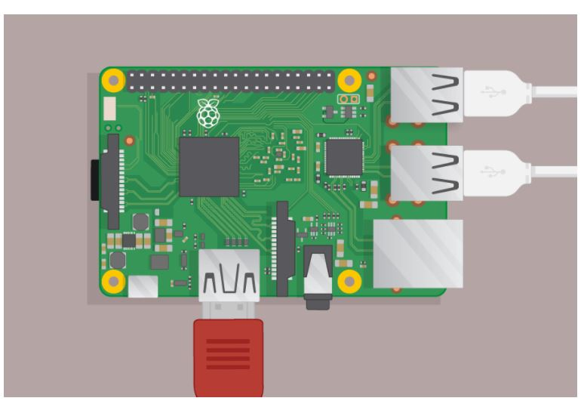
Arduino & Raspberry Pi

Slide 3
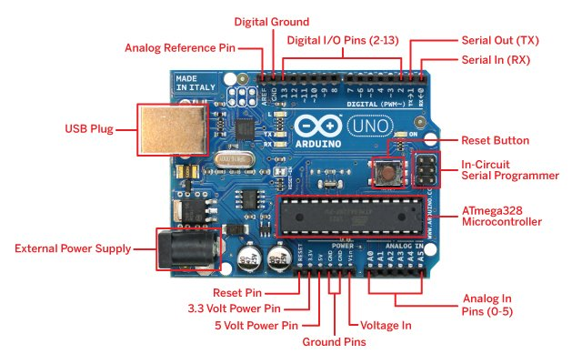
The Arduino Development Board
Making-robots-with-arduino.pdf

Slide 4
Raspberry Pi

Slide 5
What is Raspberry Pi
The Raspberry Pi is a low cost, credit-card sized computer that plugs into a computer monitor or TV, and uses a standard keyboard and mouse.
The Raspberry Pi was created in Febuary 2012 by the Raspberry Pi Foundation
Official site: www.raspberrypi.org

Slide 6
Arduino VS Raspberry Pi
 | Arduino | Raspberry Pi
Clock Speed | 16 MHz | >700 MHz
Processor | 8 Bit | 64 Bit
Operating system | Not Support | Support Operating system
Programming | Either C/C++ | Support Diff. Programming language’s
Internet | Need to use External Hardware | Easily Connected

Slide 7
Raspberry Pi Models
Raspberry Pi 3 Model B
Raspberry Pi 2 Model B
Raspberry Pi 1 Model B+
Raspberry Pi 1 Model B
Raspberry Pi 1 Model A
Raspberry Pi 1 Model A+
Raspberry Pi Zero W
Raspberry Pi Zero

Slide 8
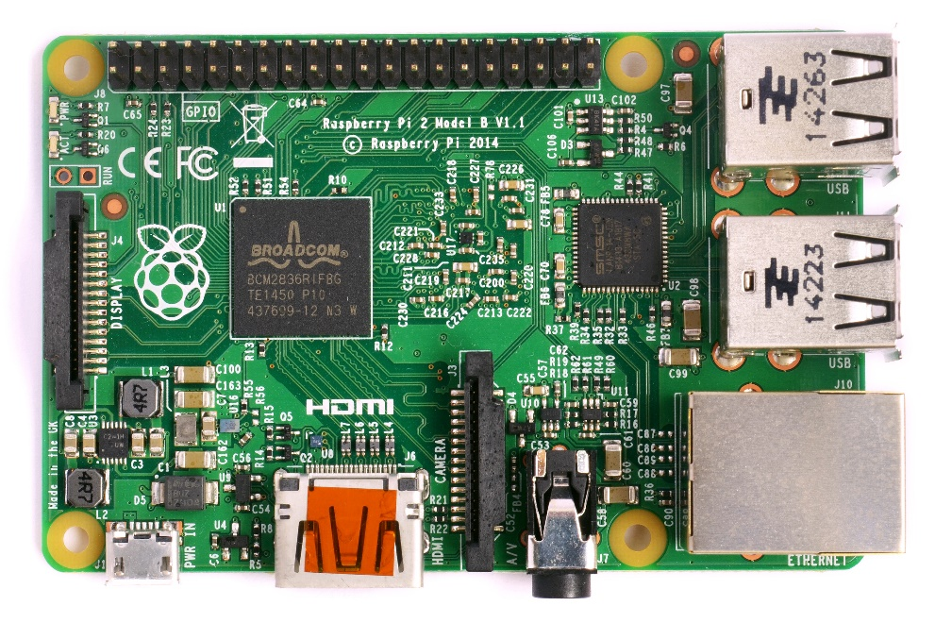
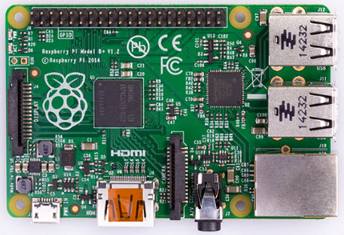
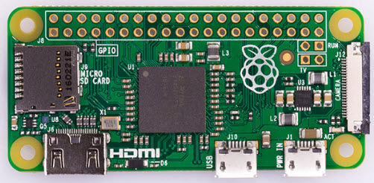
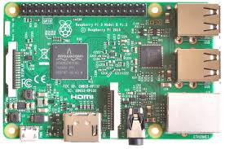
Raspberry Pi Models
Raspberry Pi 1 model B+ Raspberry Pi Zero Raspberry Pi 3 Model B

Slide 9
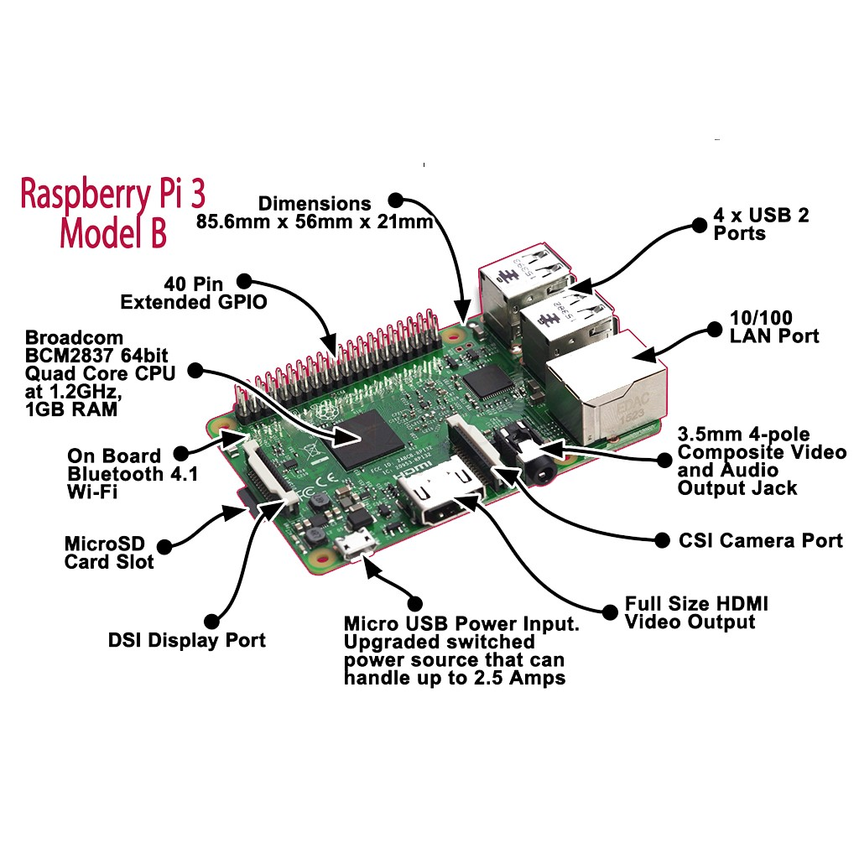
Raspberry Pi 3 Model B

Slide 10
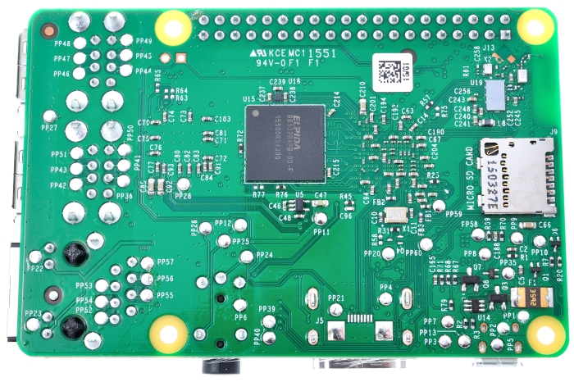
Raspberry Pi 3 Model B
BCM43438 WiFi/BT chip

Slide 11
Specifications
SoC: Broadcom BCM2837
CPU: 4× ARM Cortex-A53, 1.2GHz
GPU: Broadcom Video Core IV
RAM: 1GB LPDDR2 (900 MHz)
Networking: 10/100 Ethernet, 2.4GHz 802.11n wireless
Bluetooth: Bluetooth 4.1 Classic, Bluetooth Low Energy Storage: microSD
GPIO: 40-pin header
Ports: HDMI, 3.5mm analogue audio-video jack, 4× USB 2.0, Ethernet, Camera Serial Interface (CSI), Display Serial Interface (DSI)

Slide 12
Raspberry Pi Networking

Slide 13
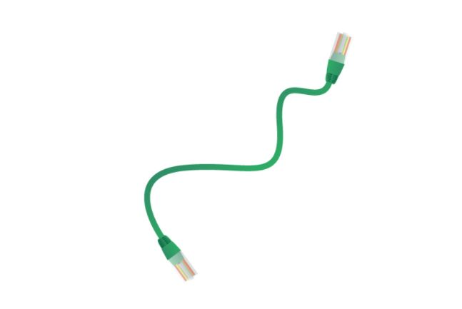
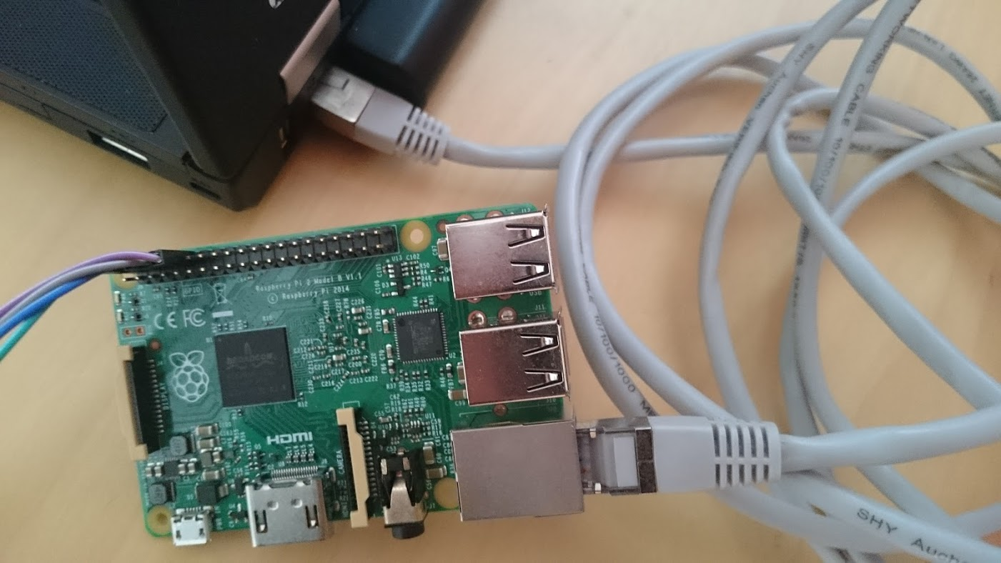
Raspberry Pi Networking-Via Ethernet

Slide 14

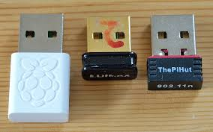
Raspberry Pi Networking-Via WiFi
Raspberry Pi-3 Built in WiFi

Slide 15
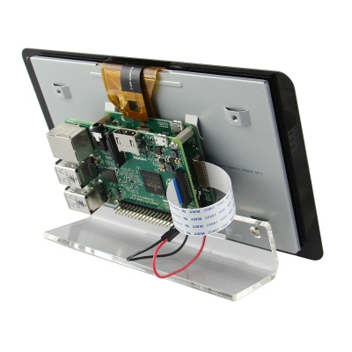
DSI(Display Serial Interface) Port
The Raspberry Pi connector S2 is a display serial interface (DSI) for connecting a liquid crystal display (LCD) panel using a 15-pin ribbon cable.
The mobile industry processor interface (MIPI) inside the Broadcom BCM2837 IC feeds graphics data directly to the display panel through this connector

Slide 16
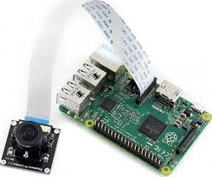
CSI(Camera Serial Interface) Port
The Raspberry Pi has a Mobile Industry Processor Interface (MIPI) Camera Serial Interface Type 2 (CSI-2), which facilitates the connection of a small camera to the main Broadcom BCM2835 processor

Slide 17
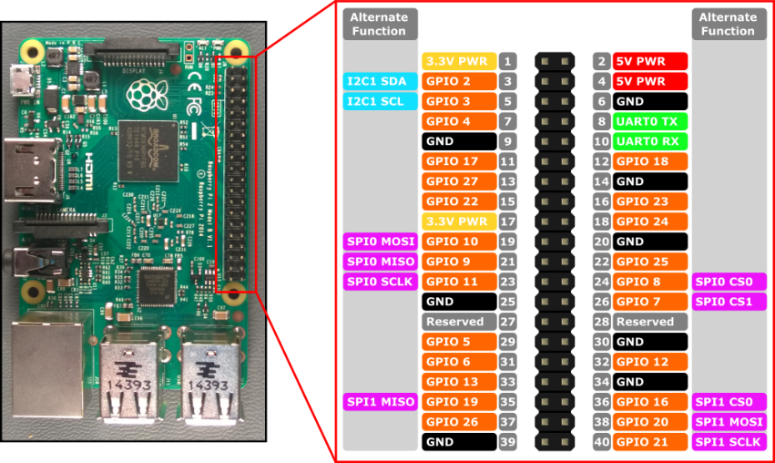
GPIO Pins

Slide 18
Equipment Needed to set up Raspberry Pi

Slide 19
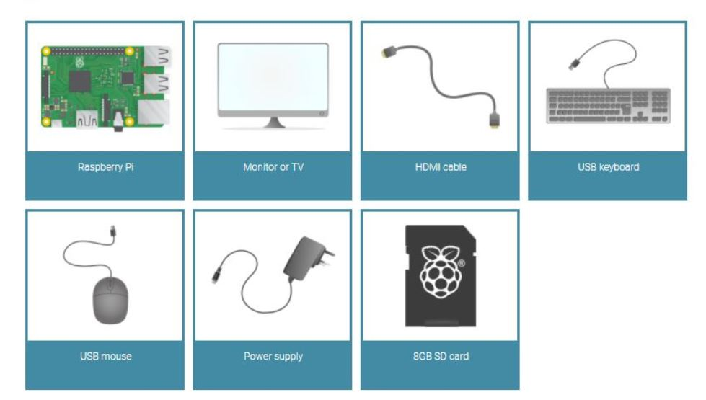
Equipment Needed..
A Monitor with VGA/HDMI cable
Power supply
USB Keyboard and Mouse
SD Card

Slide 20
Setup..

Slide 21
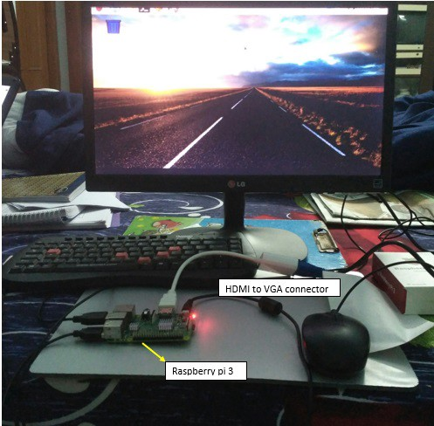
Hardware Setup..

Slide 22
Software setup..
Select the Operating System
Download the Operating system
Format SD card
Burn(Flash) the SD card

Slide 23
Operating system
NOOBS
Raspbian
Raspberry Pi Desktop
Thirty Party operating system-Ubuntu Mate
-Windows IoT core
-PINET
-RISC OS

Slide 24
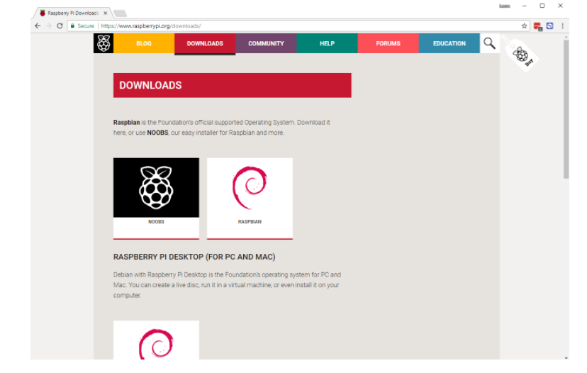
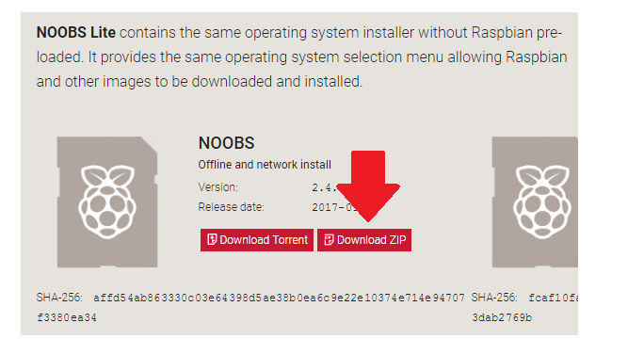
NOOBS(New Out of Box Software)
Operating systems included in NOOBS are
Raspbian
Pidora
LibreELEC
OSMC
RISC OS
Arch Linux

Slide 25
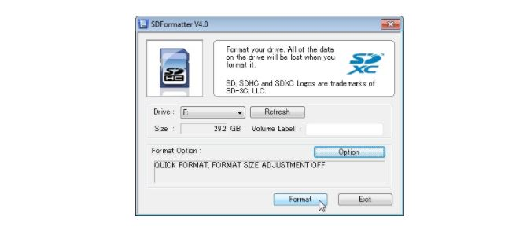
Format SD card…
Sdcard.org->Download SD card formatter
Install the software

Slide 26
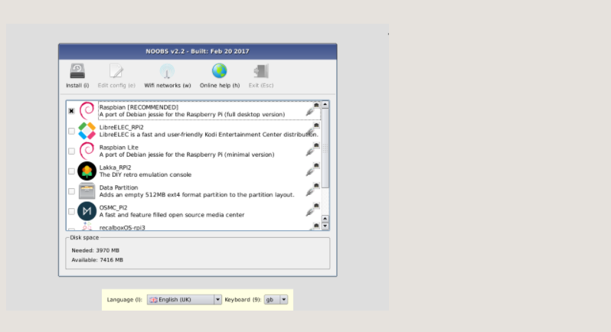
NOOBS(New Out of Box Software)
NOOBS—NOOBS
-NOOBS LITE

Slide 27

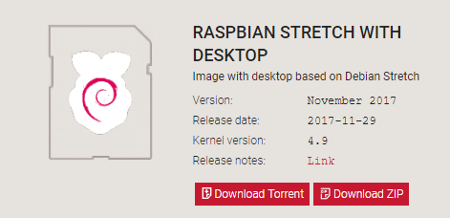
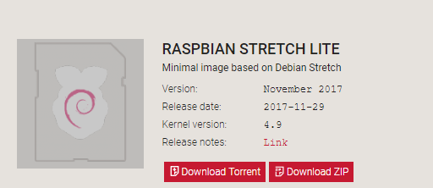
RASPBIAN
RASPBIAN STRETCH WITH DESKTOP
RASPBIAN STRETCH LITE

Slide 28
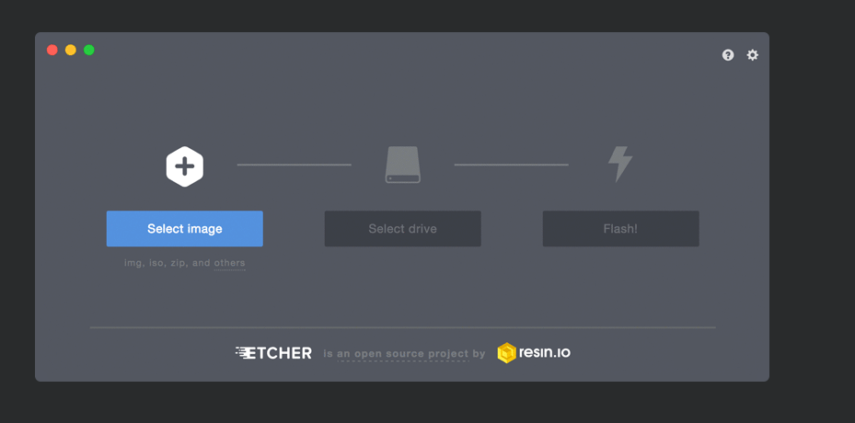
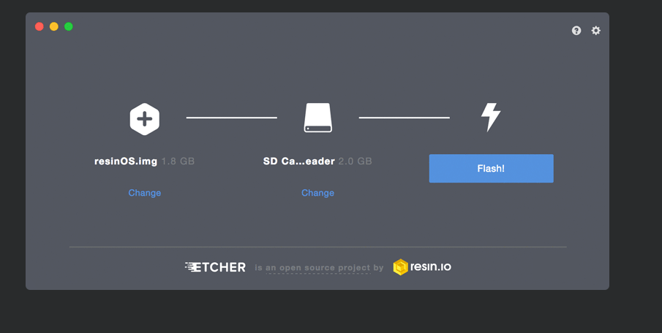
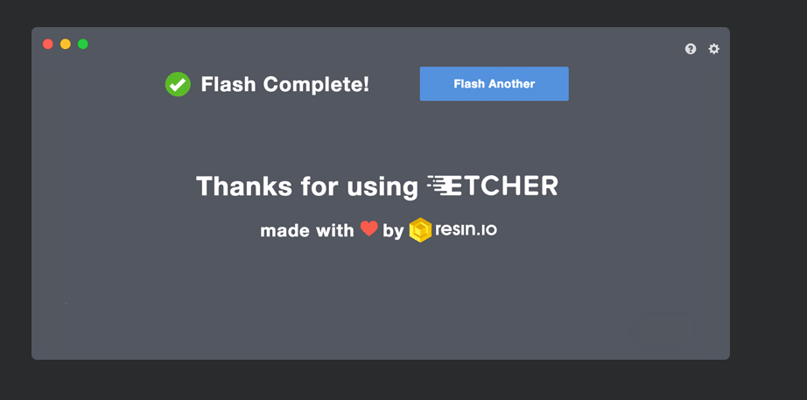
BURN(FLASH) O.S
ETCHER-Software(etcher.io)

Slide 29


